Slide 1
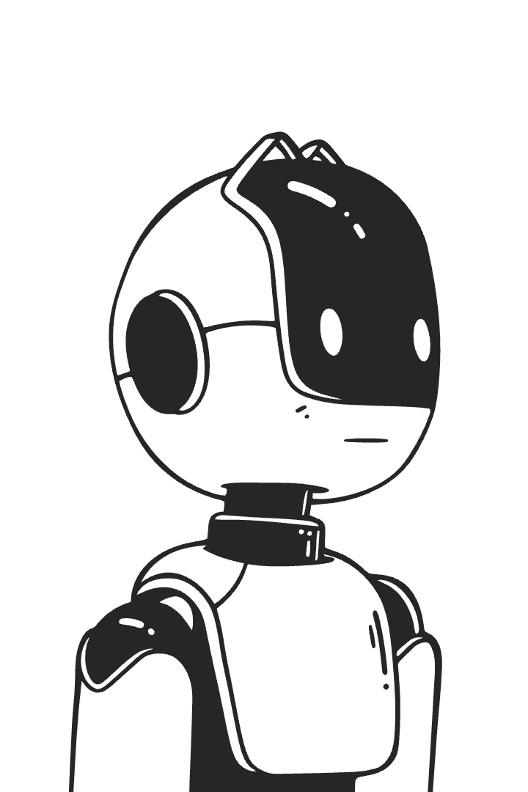
SRI KRISHNA ENGINEERING COLLEGE
Raspberry Pi-Based Autonomous Robot
Presented by: [RLC squard]
NARENDRAVEL
ADHAVAN
AKILA
SANJAY

Slide 2
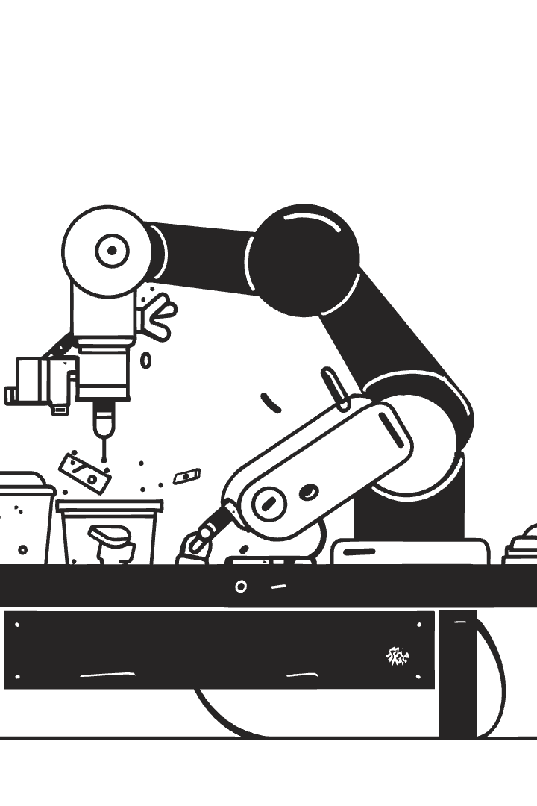
Introduction to Robotics & Raspberry Pi
Robotics & Automation
Robotics is the branch of technology that deals with the design, construction, and operation of robots—machines that can perform tasks automatically. Automation refers to the use of technology to perform tasks with minimal human intervention. Together, robotics and automation aim to increase efficiency, accuracy, and safety in industries like manufacturing, healthcare, and transportation.
Autonomous Robots
Crucial for efficiency and precision
Autonomous robots are machines that can perform tasks and make decisions without human control. They use sensors, processors, and artificial intelligence to perceive their environment, plan actions, and move independently. These robots are used in areas like self-driving cars, delivery drones, and industrial automation, where they increase efficiency and reduce the need for human intervention.
Why Raspberry Pi?
Raspberry Pi is a small, affordable, and powerful computer that's perfect for electronics and programming projects. It supports various sensors and modules, making it ideal for building robots, smart devices, and automation systems. It runs a full operating system (usually Linux), supports Python and other languages, and has GPIO pins to connect hardware directly.
Affordable, versatile single-board computer
Key Features
GPIO pins, low power, supports IoT projects

Slide 3
Project Objectives & Architecture
Project Goals
System Components
Build autonomous robot
Raspberry Pi & Camera
Obstacle avoidance & navigation
Motor driver & motors
Integrate computer vision/AI
Ultrasonic and IR sensors
Power supply & chassis

Slide 4
Hardware & Software Stack
Hardware
Software
Raspberry Pi 3B+/4
Python programming
L298N motor driver
OpenCV for vision
DC & servo motors
RPi.GPIO for control
Ultrasonic & IR sensors
Raspberry Pi OS

Slide 5
import RPi.GPIO as GPIO import time
Motor Pins
IN1 = 17 IN2 = 18 IN3 = 22 IN4 = 23 ENA = 24 ENB = 25
Ultrasonic Sensor Pins
TRIG = 5 ECHO = 6
Setup GPIO
GPIO.setmode(GPIO.BCM) GPIO.setwarnings(False)
Setup Motor Pins
motor_pins = [IN1, IN2, IN3, IN4, ENA, ENB] for pin in motor_pins: GPIO.setup(pin, GPIO.OUT)
GPIO.output(ENA, True) GPIO.output(ENB, True)
Setup Ultrasonic Pins
GPIO.setup(TRIG, GPIO.OUT) GPIO.setup(ECHO, GPIO.IN)
Motor control functions
def stop(): GPIO.output(IN1, False) GPIO.output(IN2, False) GPIO.output(IN3, False) GPIO.output(IN4, False)
def forward(): GPIO.output(IN1, True) GPIO.output(IN2, False) GPIO.output(IN3, True) GPIO.output(IN4, False)
def turn_left(): GPIO.output(IN1, False) GPIO.output(IN2, True) GPIO.output(IN3, True) GPIO.output(IN4, False)
def turn_right(): GPIO.output(IN1, True) GPIO.output(IN2, False) GPIO.output(IN3, False) GPIO.output(IN4, True)
Distance measurement function
def distance(): GPIO.output(TRIG, False) time.sleep(0.1)
GPIO.output(TRIG, True) time.sleep(0.00001) GPIO.output(TRIG, False) while GPIO.input(ECHO) == 0: pulse_start = time.time() while GPIO.input(ECHO) == 1: pulse_end = time.time() pulse_duration = pulse_end - pulse_start dist = pulse_duration * 17150 dist = round(dist, 2) return dist
Main loop
try: while True: dist = distance() print(f"Distance: {dist} cm")
if dist < 20: stop() time.sleep(0.5) turn_right() time.sleep(0.6) stop() else: forward() time.sleep(0.1)
except KeyboardInterrupt: GPIO.cleanup()

Slide 6
Sensors & Control Flow
Ultrasonic Sensor
Motor Driver
Control Logic
#Measures distance to obstacles
Controls motor speed and direction
Stops and turns robot when obstacle detected
An ultrasonic sensor measures distance by using sound waves. It emits a high-frequency sound pulse (ultrasound), waits for the echo to return, and calculates the distance based on the time taken.
Motor drivers allow robots and other devices to move by controlling DC motors, stepper motors, or servo motors.
It helps create logical, dynamic, and responsive behavior in programs—essential for tasks like sensor checks, motor control, and decision-making in robotics.

Slide 7
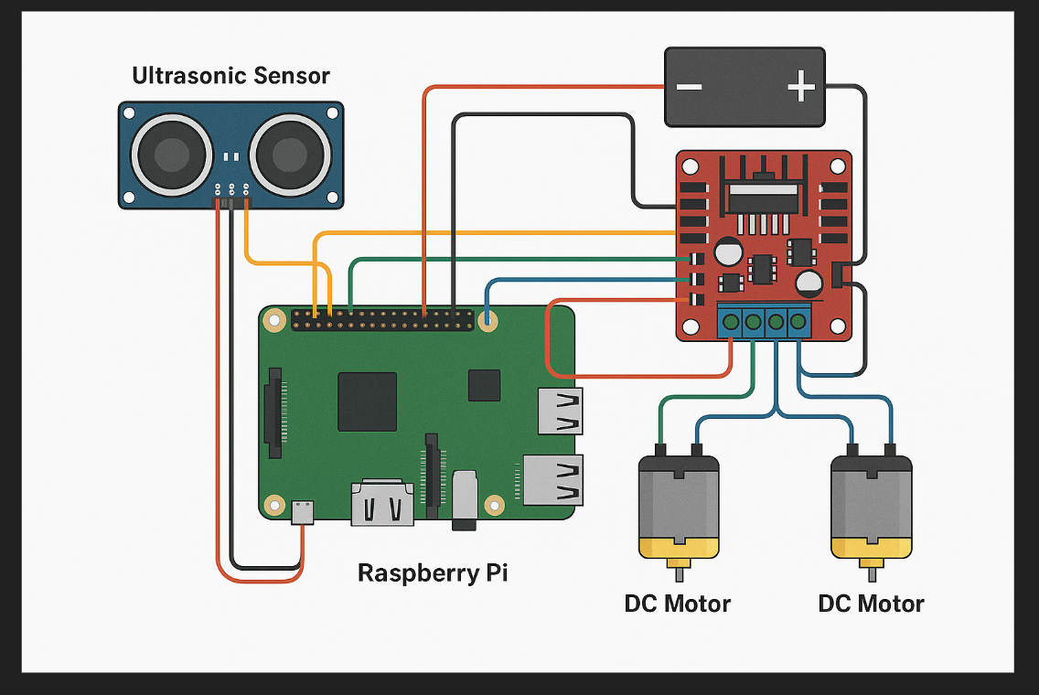
CIRCUIT DIAGRAM:

Slide 8
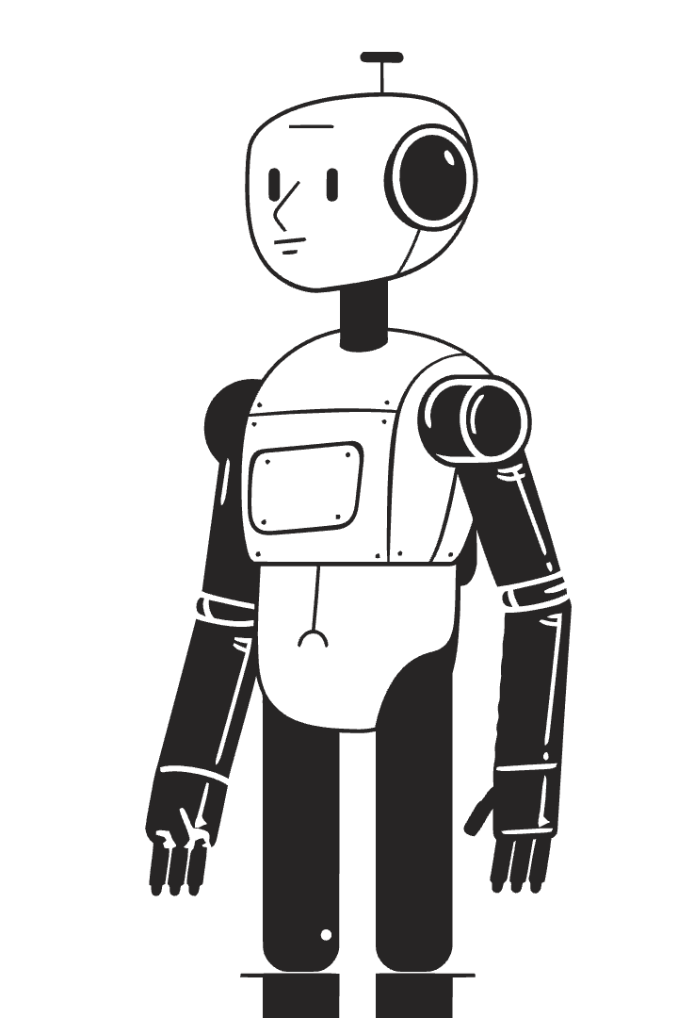
Testing & Performance
1
Performance Metrics
Accuracy of obstacle detection
2
Speed
Responsive navigation in real-time
3
Challenges
Sensor noise, power management
4
Solutions
Signal filtering, optimized power supply

Slide 9
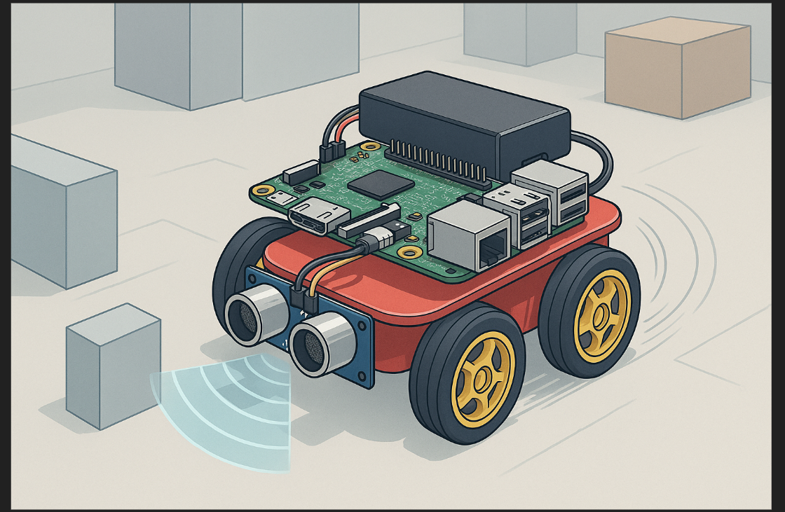
RESPBERRY-PI-BASED AUTONOMUS ROBOT:

Slide 10

Applications of Autonomous Robots
Education
Smart Warehouses
Home Automation
Hands-on STEM learning
Automation of logistics
Assistance & monitoring
Search & Rescue
Prototype development

Slide 11
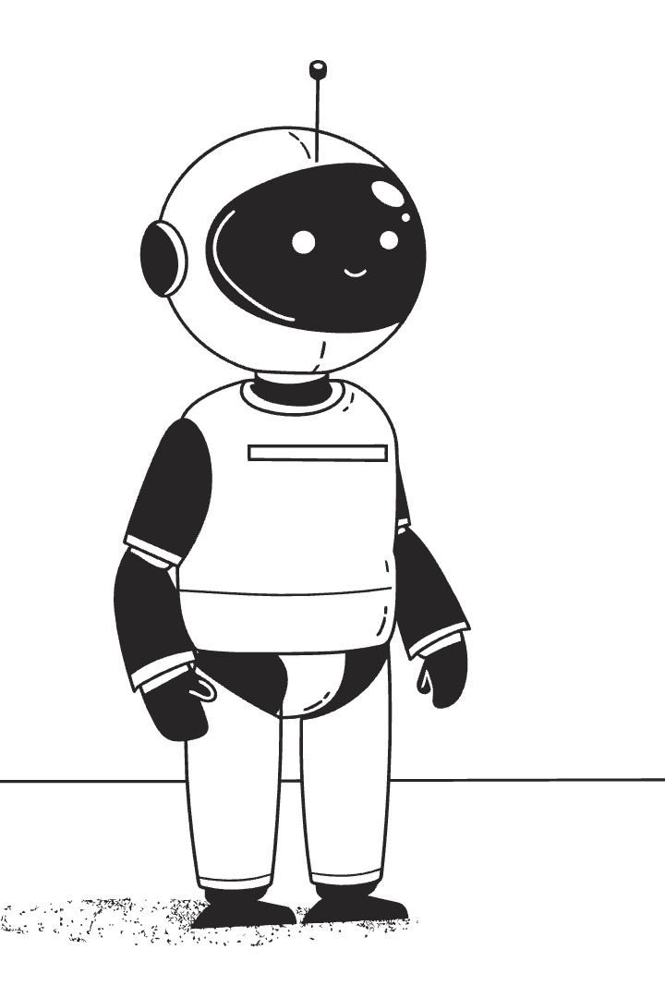

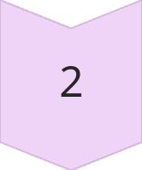
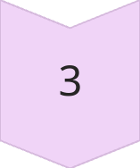
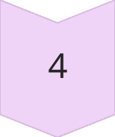
Future Enhancements
AI Integration
Object detection and decision-making
Wireless Control
Wi-Fi and Bluetooth connectivity
GPS
Enhanced navigation capabilities
Voice Commands
Natural user interaction

Slide 12
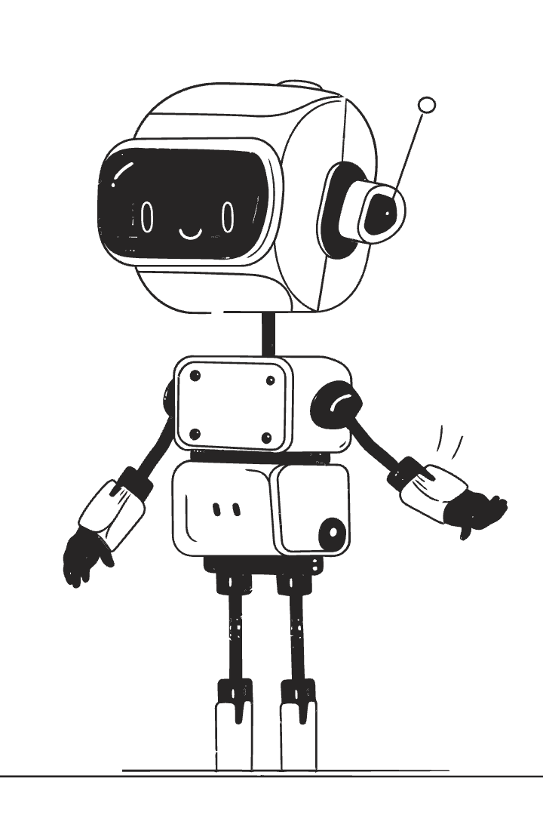
Conclusion & Takeaways
Project Recap
Built Raspberry Pi autonomous robot
Learnings
Applied hardware and software integration
Future Potential
Scalable for advanced robotics projects

